Slide 1

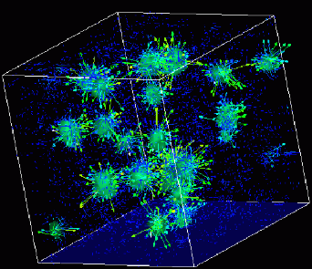

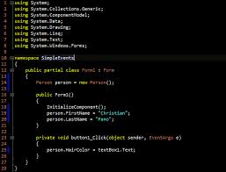
Advanced
Scientific Computing
(SciComp 201)
Session 24
Monte Carlo Integration

Slide 2
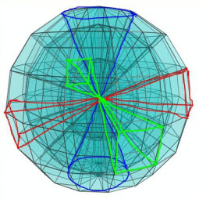
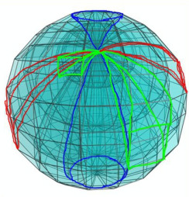
An Interesting Question
What is the volume of a four-dimensional unit hypersphere?
What does a 4D sphere “look” like?
What is a “unit” sphere?
Where do I even start?
Break down complex questions into simpler steps:
How can we calculate the area of a 2D circle?
How can we calculate the volume of a 3D sphere?
How do we move from 3D to 4D?

Slide 3
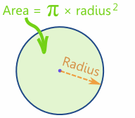
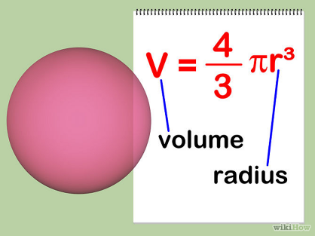
Area and Volume

Slide 4
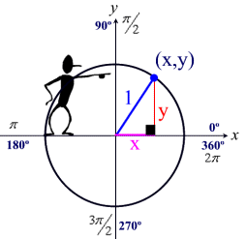
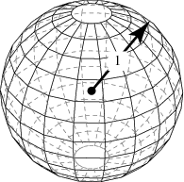
A Unit Circle and Unit Sphere

Slide 5
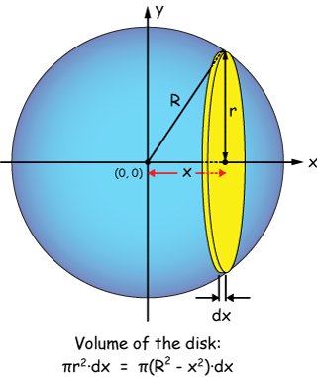
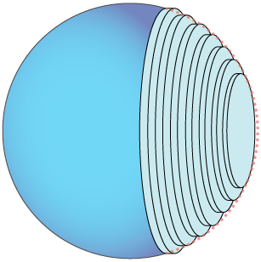
2-D Area → 3-D Volume

Slide 6
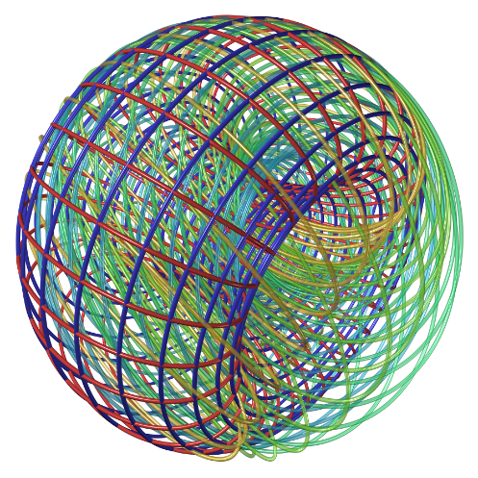
A 4-D Hypersphere
How do we calculate the volume of something we can not even imagine?

Slide 7
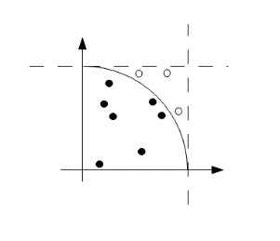
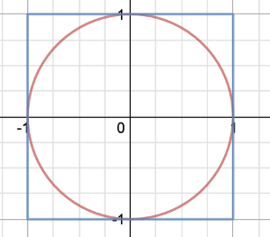
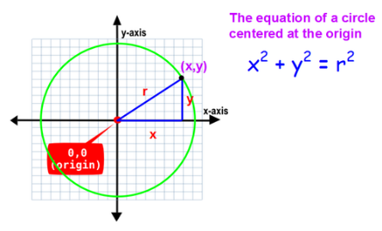
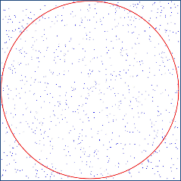
Area as a “Ratio” of Inside vs. Outside Dots
We pick a million random points and count how many are inside the circle

Slide 8
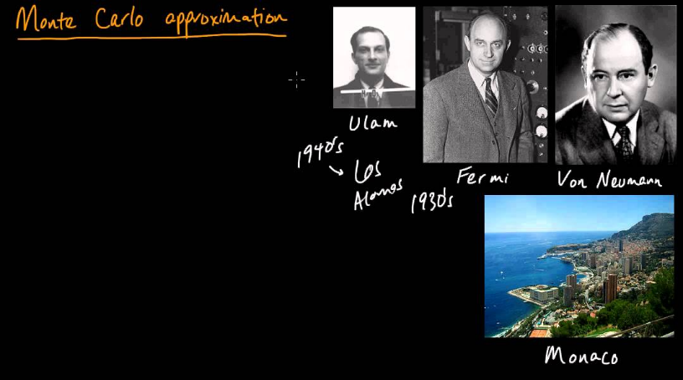
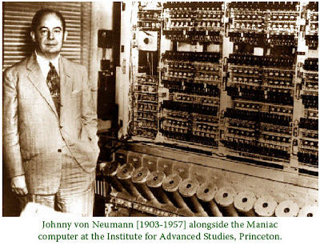
The Monte Carlo Method

Slide 9
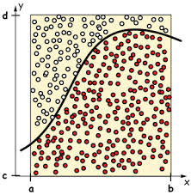
The Monte Carlo Method
With Monte Carlo, we randomly sample points across the entire space and count how many are below the curve
The ratio between points below the curve to total points is an estimate of the area
Monte Carlo is a non-deterministic approach because it uses a pseudo-random number generator

Slide 10
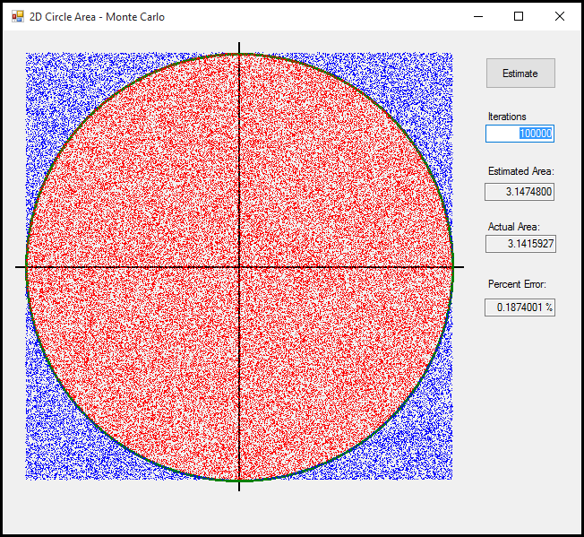
2-D Area as a “Ratio” of Dots
Run Lab 1

Slide 11
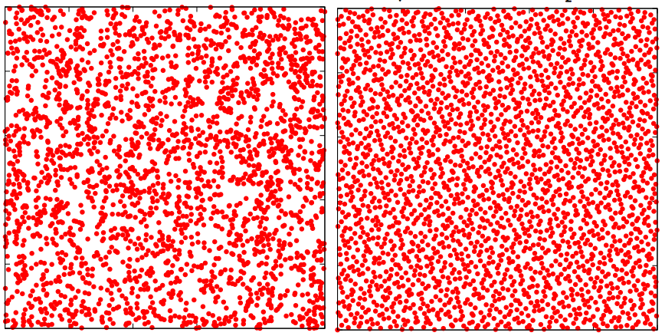

Comparing “Random” Number Generators
Standard PRNG
Niederreiter QRNG
The Niederreiter sequence generates a smoother distribution of “random” points

Slide 12
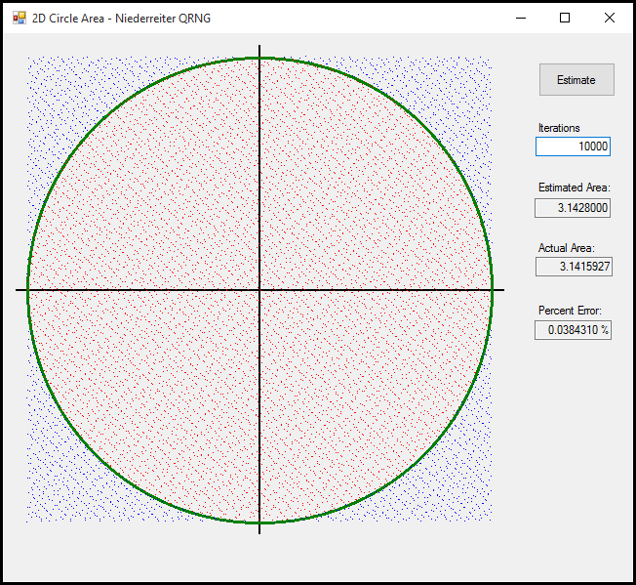
Improved 2-D Monte Carlo Estimator
Run Lab 2

Slide 13
Improved 2-D Monte Carlo Estimator
The Niederreiter sequence provides a 6X increase in accuracy of the estimate using 10X fewer points!

Slide 14
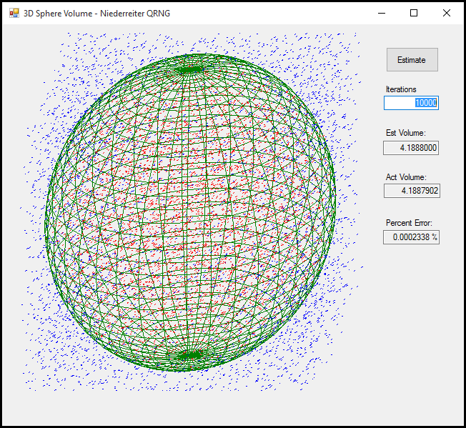
3-D Unit Sphere Volume Estimator
Run Lab 3
$$=\frac{4π}{3}$$

Slide 15
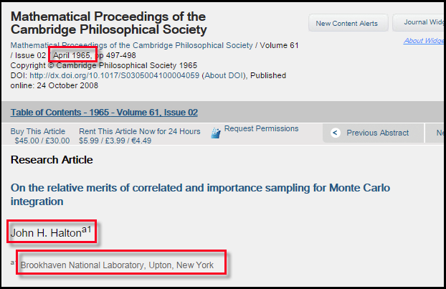
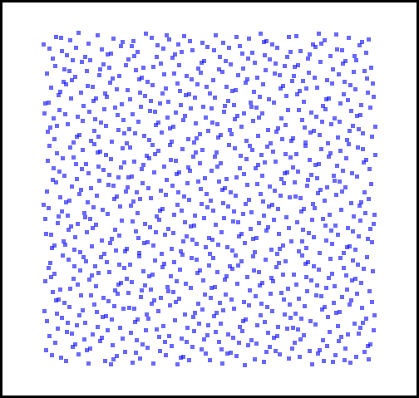
The Halton Sequence

Slide 16
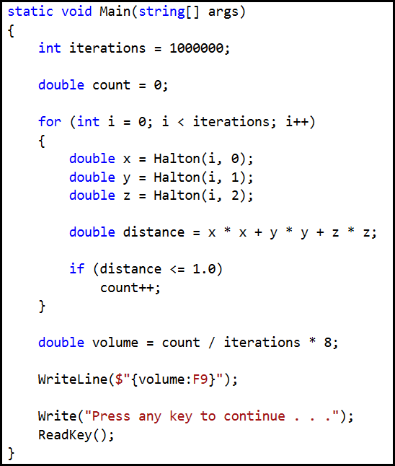
Accommodating the 4th Dimension
We need to update this code to include the 4th dimension!
Open and edit Lab 4

Slide 17
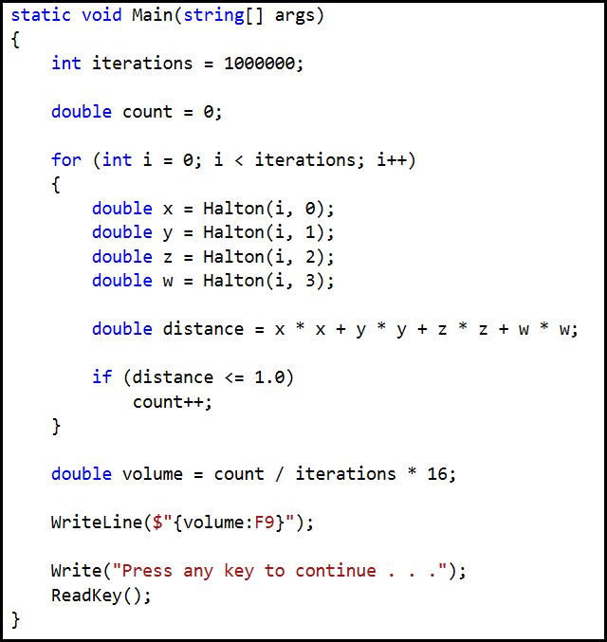
Accommodating the 4th Dimension
Add all the code in red, and then click “Start” in Visual Studio!

Slide 18

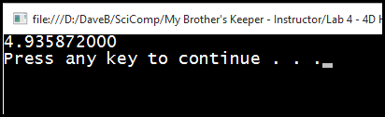
What is the volume of a 4-D hypersphere?
= $\frac{π^{2}}{2}$

Slide 19
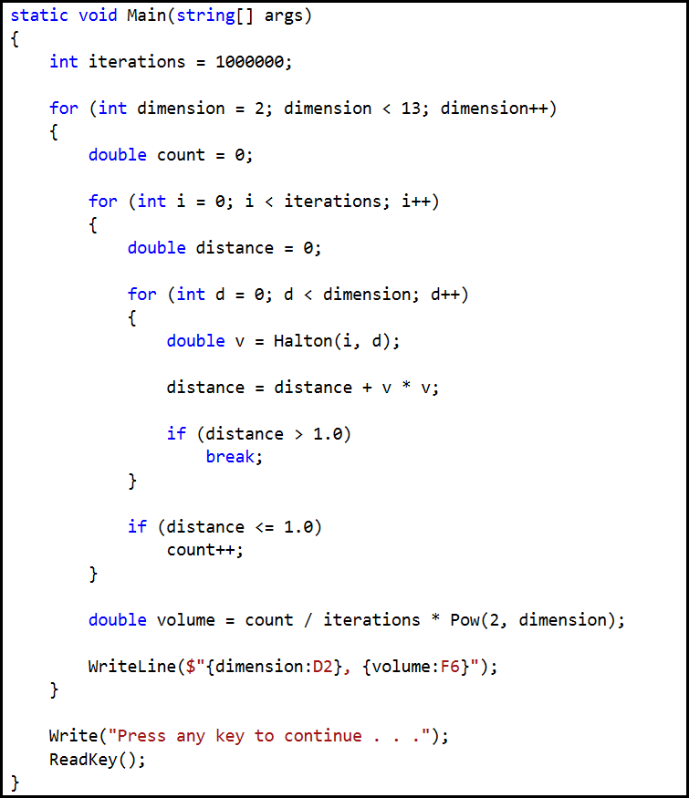
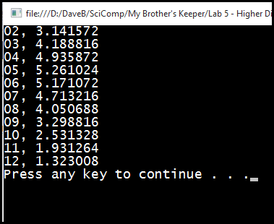
What lurks beyond the 4th dimension?
This code will estimate the volume up to the 12th dimension!
Run Lab 5

Slide 20
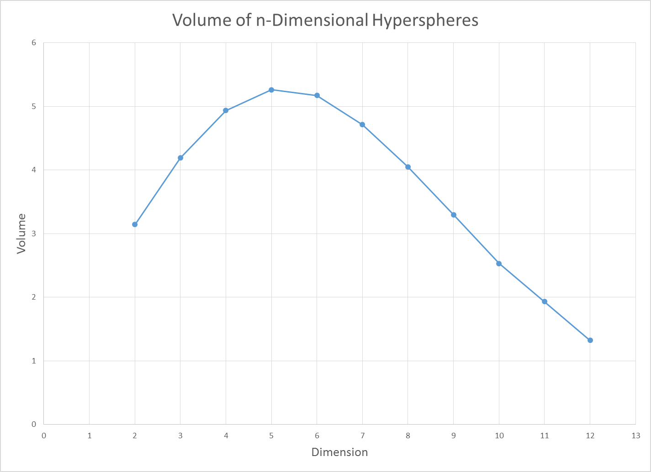
What lurks beyond the 4th dimension?
The volume decreases in each higher dimension!
A 5-D unit hypersphere has the maximal volume!

Slide 21
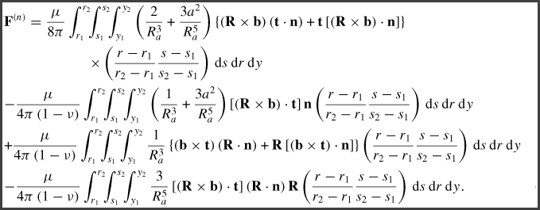
The Power Of Monte Carlo Integration

Slide 22
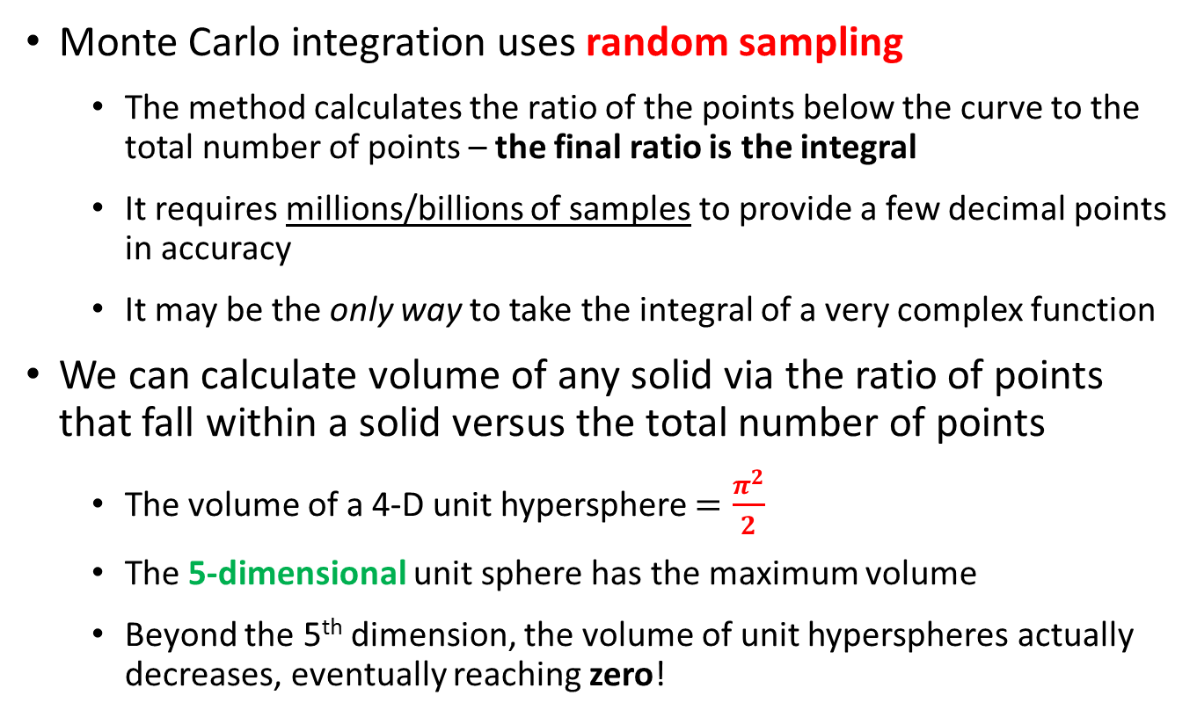
Now you know…
Monte Carlo integration uses random sampling
The method calculates the ratio of the points below the curve to the total number of points – the final ratio is the integral
It requires millions/billions of samples to provide a few decimal points in accuracy
It may be the only way to take the integral of a very complex function
We can calculate volume of any solid via the ratio of points that fall within a solid versus the total number of points
The volume of a 4-D unit hypersphere $=\frac{π^{2}}{2}$
The 5-dimensional unit sphere has the maximum volume
Beyond the 5th dimension, the volume of unit hyperspheres actually decreases, eventually reaching zero!

